Slide 1
Biodiversity

Slide 2
By the end of this lesson, you should be able to:
1. | Identify what biodiversity is.
2. | Explain why biodiversity is important.

Slide 3
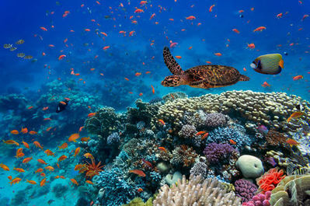
Biodiversity is defined as the range of different species present in an ecosystem.
The more species you have interacting with each other, the higher the biodiversity. For instance, the Great Barrier Reef has very high biodiversity, because it's home to thousands (possibly even millions) of interacting species.

Slide 4
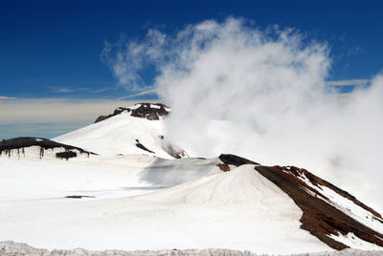
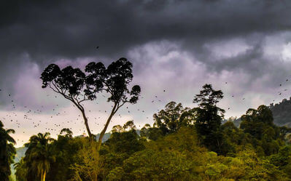
By contrast, places with very few species have low biodiversity.
If these species are affected by a lethal disease, or a catastrophic natural disaster, the whole ecosystem could be wiped out!
This is why biodiversity is important - it increases the resilience of an ecosystem. When all members of a species die, the species becomes extinct. In ecosystems with many different species, there is more chance of some species surviving a natural disaster or problem.

Slide 5
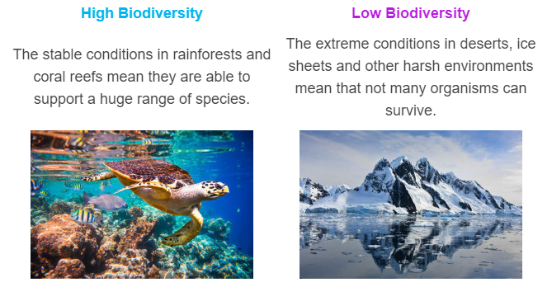
So, what kinds of ecosystems have high and low biodiversity?

Slide 6
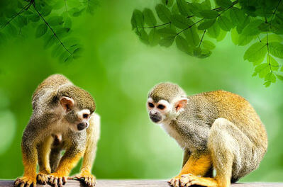
The most biodiverse region in the world is considered to be the Amazon rainforest. It covers a large part of the South American continent and is home to:
2,000 species of birds and mammals
40,000 species of plants
2,500,000 species of insects
That's a lot of life!

